Slide 1
Resolution in FOL
Unit-4
https://www.javatpoint.com/ai-resolution-in-first-order-logic

Slide 2
Resolution in FOL
Resolution is a theorem proving technique that proceeds by building refutation proofs, i.e., proofs by contradictions. It was invented by a Mathematician John Alan Robinson in the year 1965.
Resolution is used, if there various statements are given, and we need to prove a conclusion of those statements.
Unification is a key concept in proofs by resolutions. Resolution is a single inference rule which can efficiently operate on the conjunctive normal form or clausal form.
Clause: Disjunction of literals (an atomic sentence) is called a clause. It is also known as a unit clause.
Conjunctive Normal Form: A sentence represented as a conjunction of clauses is said to be conjunctive normal form or CNF.

Slide 3
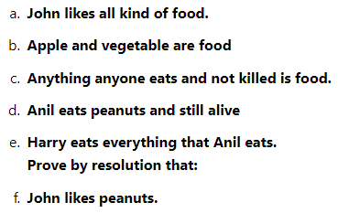
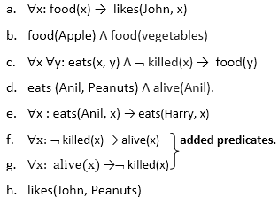
Examples- Step-1: Conversion of Facts into FOL

Slide 4
Step-2: Conversion of FOL into CNF
Eliminate all implication (→) and rewrite
∀x ¬ food(x) V likes(John, x)
food(Apple) Λ food(vegetables)
∀x ∀y ¬ [eats(x, y) Λ ¬ killed(x)] V food(y)
eats (Anil, Peanuts) Λ alive(Anil)
∀x ¬ eats(Anil, x) V eats(Harry, x)
∀x¬ [¬ killed(x) ] V alive(x)
∀x ¬ alive(x) V ¬ killed(x)
likes(John, Peanuts).

Slide 5
Step-2: Conversion of FOL into CNF
Move negation (¬)inwards and rewrite
∀x ¬ food(x) V likes(John, x)
food(Apple) Λ food(vegetables)
∀x ∀y ¬ eats(x, y) V killed(x) V food(y)
eats (Anil, Peanuts) Λ alive(Anil)
∀x ¬ eats(Anil, x) V eats(Harry, x)
∀x ¬killed(x) ] V alive(x)
∀x ¬ alive(x) V ¬ killed(x)
likes(John, Peanuts).

Slide 6
Step-2: Conversion of FOL into CNF
Rename variables or standardize variables
∀x ¬ food(x) V likes(John, x)
food(Apple) Λ food(vegetables)
∀y ∀z ¬ eats(y, z) V killed(y) V food(z)
eats (Anil, Peanuts) Λ alive(Anil)
∀w¬ eats(Anil, w) V eats(Harry, w)
∀g ¬killed(g) ] V alive(g)
∀k ¬ alive(k) V ¬ killed(k)
likes(John, Peanuts).

Slide 7
Step-2: Conversion of FOL into CNF
Eliminate existential instantiation quantifier by elimination. In this step, we will eliminate existential quantifier ∃, and this process is known as Skolemization. But in this example problem since there is no existential quantifier so all the statements will remain same in this step.

Slide 8
Step-2: Conversion of FOL into CNF
Drop Universal quantifiers. In this step we will drop all universal quantifier since all the statements are not implicitly quantified so we don't need it.
¬ food(x) V likes(John, x)
food(Apple)
food(vegetables)
¬ eats(y, z) V killed(y) V food(z)
eats (Anil, Peanuts)
alive(Anil)
¬ eats(Anil, w) V eats(Harry, w)
killed(g) V alive(g)
¬ alive(k) V ¬ killed(k)
likes(John, Peanuts).

Slide 9
Step-3: Negate the statement to be proved
Distribute conjunction ∧ over disjunction ¬. This step will not make any change in this problem.
Step-3: Negate the statement to be proved
In this statement, we will apply negation to the conclusion statements, which will be written as ¬likes(John, Peanuts)

Slide 10
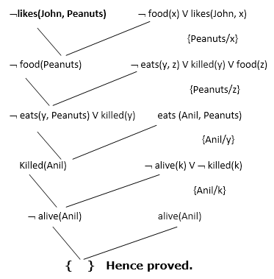
Step-4: Draw Resolution graph:

Slide 11
Explanation of Resolution graph:
In the first step of resolution graph, ¬likes(John, Peanuts) , and likes(John, x) get resolved(canceled) by substitution of {Peanuts/x}, and we are left with ¬ food(Peanuts)
In the second step of the resolution graph, ¬ food(Peanuts) , and food(z) get resolved (canceled) by substitution of { Peanuts/z}, and we are left with ¬ eats(y, Peanuts) V killed(y) .
In the third step of the resolution graph, ¬ eats(y, Peanuts) and eats (Anil, Peanuts) get resolved by substitution {Anil/y}, and we are left with Killed(Anil) .
In the fourth step of the resolution graph, Killed(Anil) and ¬ killed(k) get resolve by substitution {Anil/k}, and we are left with ¬ alive(Anil) .
In the last step of the resolution graph ¬ alive(Anil) and alive(Anil) get resolved.

Slide 12
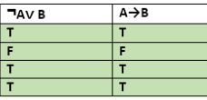
Resolution example-
• KB:
– allergies(X) → sneeze(X)
– cat(Y) ∧ allergicToCats(X) → allergies(X)
– cat(felix)
– allergicToCats(mary)
•
Goal:
– sneeze(mary)

Slide 13
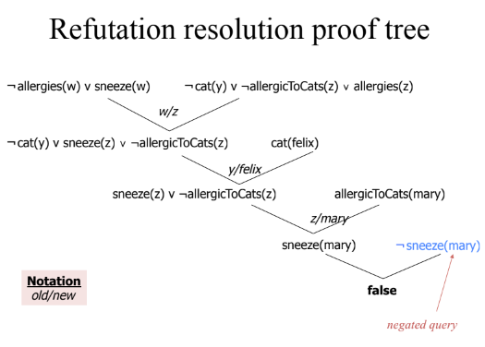


Slide 14
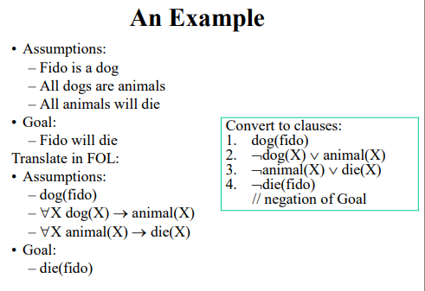

Slide 15
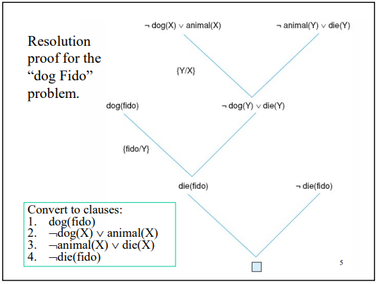

Slide 16
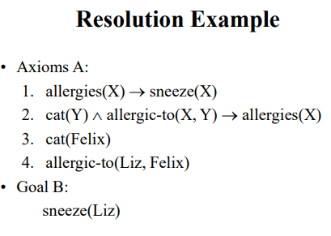

Slide 17
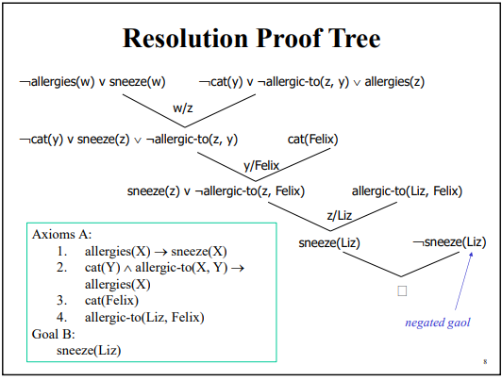

Slide 18
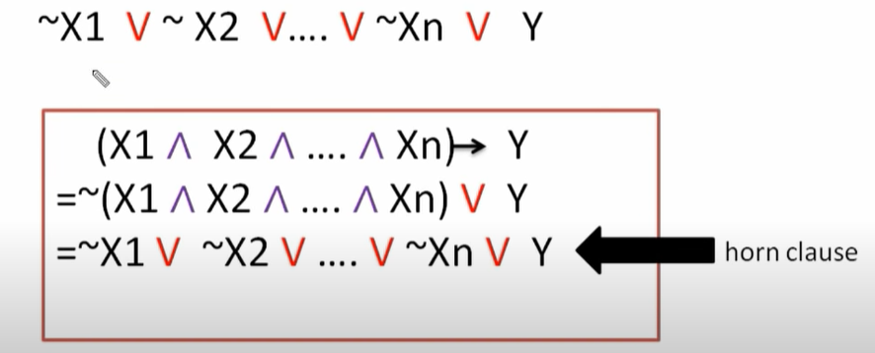
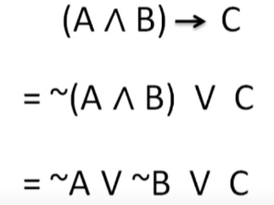
Representation knowledge using rules
Horn Clause- A horn clause is a disjunction with at most one positive literal.

Slide 19
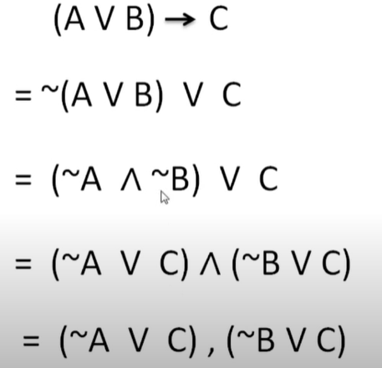
WFF to Horn Clause - Example
DE morgan’s law
Distributive property

Slide 20
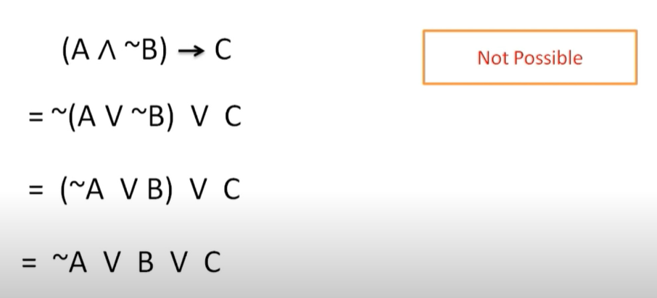
Horn Clause

Slide 21
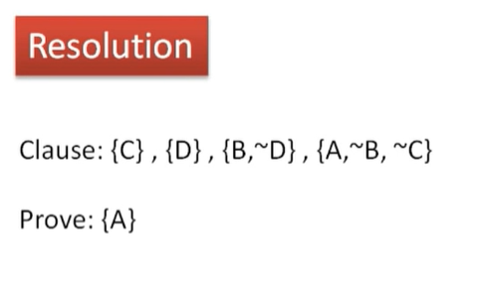

Slide 22
Backward and forward Chaining video
https://www.youtube.com/watch?v=W5O8QAWu-OM
https://www.youtube.com/watch?v=PBTSdx_C9WM
https://www.javatpoint.com/forward-chaining-and-backward-chaining-in-ai

Slide 23
Difference between backward chaining and forward chaining
Forward chaining as the name suggests, start from the known facts and move forward by applying inference rules to extract more data, and it continues until it reaches to the goal, whereas backward chaining starts from the goal, move backward by using inference rules to determine the facts that satisfy the goal.

Slide 24
Difference between backward chaining and forward chaining
Forward Chaining | Backward Chaining
Forward chaining starts from known facts and applies inference rule to extract more data unit it reaches to the goal. | Backward chaining starts from the goal and works backward through inference rules to find the required facts that support the goal.
It is a bottom-up approach | It is a top-down approach
Forward chaining is known as data-driven inference technique as we reach to the goal using the available data. | Backward chaining is known as goal-driven technique as we start from the goal and divide into sub-goal to extract the facts.
Forward chaining reasoning applies a breadth-first search strategy. | Backward chaining reasoning applies a depth-first search strategy.

Slide 25
Difference between backward chaining and forward chaining
Forward Chaining | Backward Chaining
Forward chaining tests for all the available rules | Backward chaining only tests for few required rules.
Forward chaining is suitable for the planning, monitoring, control, and interpretation application. | Backward chaining is suitable for diagnostic, prescription, and debugging application.
Forward chaining can generate an infinite number of possible conclusions. | Backward chaining generates a finite number of possible conclusions.
Forward chaining is aimed for any conclusion. | Backward chaining is only aimed for the required data.

Slide 26
forward chaining - Example
If D barks and D eats bone, then D is a dog.
If V is cold and V is sweet, then V is ice-cream.
If D is a dog, then D is black.
If V is ice-cream, then it is Vanilla.
Derive forward chaining using the given known facts to prove Tomy is black.
Tomy barks.
Tomy eats bone.

Slide 27
backward chaining
Consider the below axioms:
Gita loves all types of clothes.
Suits are clothes.
Jackets are clothes.
Anything any wear and isn’t bad is clothes.
Sita wears skirt and is good.
Renu wears anything Sita wears.
Apply backward chaining and prove that Gita loves Kurtis.

Slide 28
Solution: Convert the given axioms into FOPL as:
x: clothes(x) ^loves(Gita, x).
Suits(x)->Clothes(x).
Jackets(x)?Clothes(x).
wears(x,y)? ¬bad(y)?Clothes(x)
wears(Sita,skirt) ? ¬good(Sita)
wears(Sita,x)?wears(Renu,x)
To prove: Gita loves Kurtis.
FOPL: loves(Gita, Kurtis).

